Slide 1
Why Statistical Inference
1-<number>

Slide 2
Why Use Statistical Inference
Whenever we collect data, we want our results to be true for the entire population and not just the sample that we used
But our sample may not be representative of the population
Inferential statistics allow us to decide if our sample results are probably true for the population
Inferential statistics also allow us to decide if a treatment probably had an effect

Slide 3
Point Estimates
One of our fundamental questions is: “How well does our sample statistic estimate the value of the population parameter?”
Equivalently, we may ask “Is our point estimate good?”
  A point estimate is a statistic (e.g. X) that is calculated from sample data in order to estimate the value of the population parameter (e.g. μ)

Slide 4
Point Estimates
What makes a point estimate “good”?
First, we must define “good”
  A good estimate is one that is close to the actual value
  What statistic is used to calculate how close a value is to another?
    A difference score, or deviate score (X - μ)
  What statistic should we use to measure the average “goodness?”
    Standard deviation

Slide 5
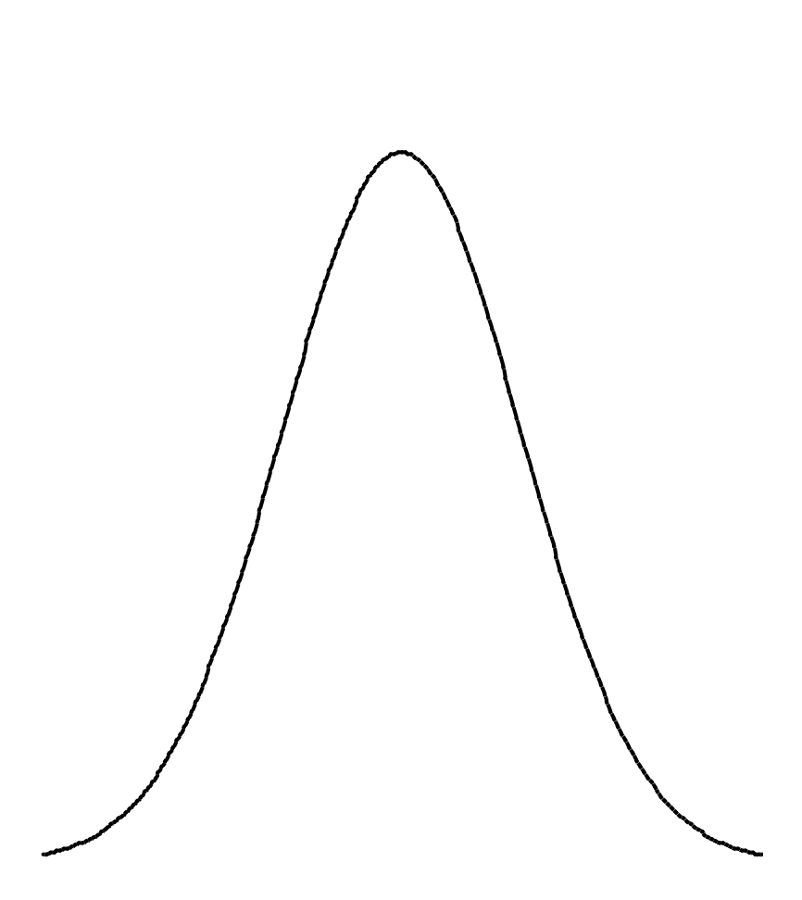
Sampling Distribution
Draw a sample from the population
Calculate the point estimate
Repeat the previous two steps many times
Draw a frequency distribution of the point estimates
That distribution is called a sampling distribution

Slide 6
Standard Error of the Mean
The standard error of the mean is the standard deviation of the sampling distribution
Thus, it is measure of how good our point estimate is likely to be
The symbol s_{X} represents the standard error of the mean

Slide 7
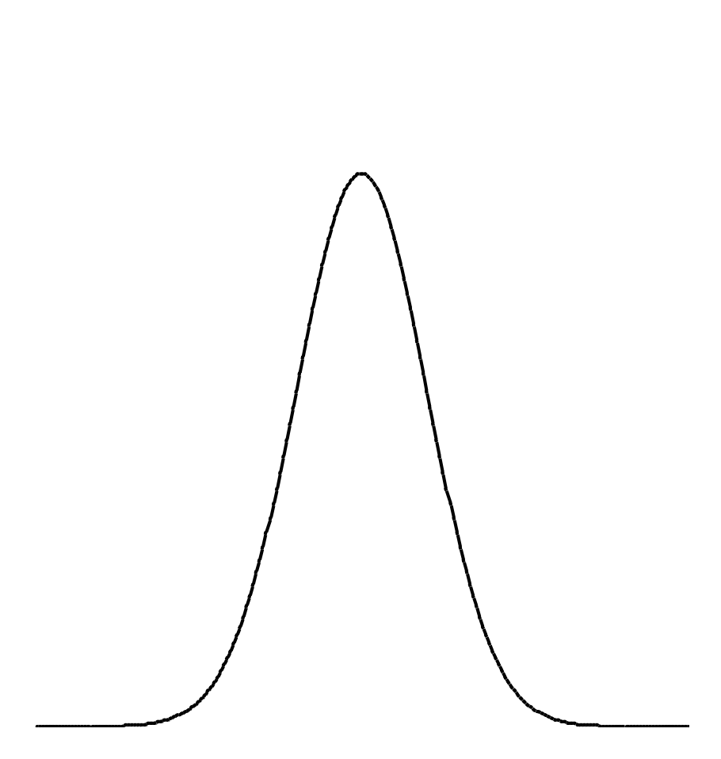
Which Sampling Distribution Is Better?
Which sampling distribution is better? Why?

Slide 8
Factors Influencing s_{X}
What influences the size of the standard error of the mean?
  That is, what can you do to make the sample mean closer to the population mean (on average)?
Increase sample size!
  A sample mean based on a single observation will not be as accurate as a sample mean based on 10 or 100 observations

Slide 9
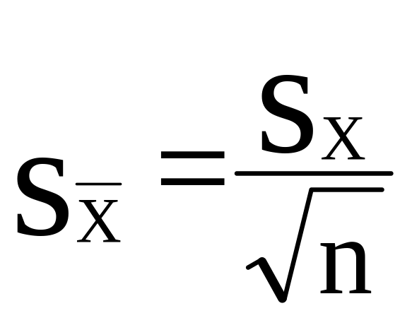
Standard Error of the Mean
The standard error of the mean can be estimated from the standard deviation of the sample:

Slide 10
Central Limit Theorem
The central limit theorem states that the shape of a sampling distribution will be normal (or Gaussian) as long as the sample size is sufficiently large
The mean of the sampling distribution will equal the mean of the population
The standard deviation of the sampling distribution (I.e. the standard error of the mean) will equal the standard deviation of the samples divided by the √ n

Slide 11
Confidence Intervals
How confident are we in our point estimate of the population mean?
  The population mean almost always is larger or smaller than the sample mean
Given the sample mean and standard deviation, we can infer an interval, or range of scores, that probably contain the population mean
This interval is called the confidence interval

Slide 12
Confidence Intervals
Because of the central limit theorem, the sampling distribution of means is normally distributed, as long as the sample size is sufficiently large
We can use the table of areas under the normal curve to find a range of numbers that probably contain the population mean

Slide 13
Confidence Intervals
The area under the normal curve between z-scores of -1 and +1 is .68
Thus, the 68% confidence interval is given by X ± 1 standard deviation of the sampling distribution
E.g., X = 4.32 s_{X} = .57, n = 32
X ± z x s_{X} / √n
4.32 - .57 / √32 to 4.32 + .57 / √32
4.22 to 4.42

Slide 14
Confidence Intervals
The area under the normal curve between z-scores of -1.96 and +1.96 is .95
Thus, the 95% confidence interval is given by X ± 1.96 standard deviation of the sampling distribution
E.g., X = 4.32 s_{X} = .57, n = 32
X ± z X s_{X} / √n
4.32 - 1.96 X .57 / √32 to 4.32 + 1.96 X .57 / √32
4.12 to 4.52

Slide 15
Hypothesis Testing
Hypothesis testing is the procedure by which we infer if two (or more) groups are different from each other
The first step is to write the statistical hypotheses which are expressed in precise mathematical terms
The statistical hypotheses always come in pairs -- the null hypothesis and the alternative hypothesis

Slide 16
H₀: The Null Hypothesis
The null hypothesis usually takes the following form:
H₀: μ₁ = μ₂
This is read as: “The null hypothesis is that the mean of condition one equals the mean of condition two”
Notice that the null hypothesis always deals with population parameters and not the sample statistics

Slide 17
H₀
The null hypothesis must contain an equal sign of some sort (=, ≥, ≤)
Statistical tests are designed to reject H₀, never to accept it

Slide 18
H₁: The Alternative Hypothesis
The alternative hypothesis usually takes the following form:
H₁: μ₁ ≠ μ₂
This is read as: “The alternative hypothesis states that the mean of condition one does not equal the mean of condition two”
As is true for the null, the alternative hypothesis deals with the population parameter and not the sample statistic

Slide 19
H₀ and H₁
Together, the null and alternative hypotheses must be mutually exclusive and exhaustive
Mutual exclusion implies that H₀ and H₁ cannot both be true at the same time
Exhaustive implies that each of the possible outcomes of the experiment must make either H₀ or H₁ true

Slide 20
Directional vs Non-Directional Hypotheses
The hypotheses we have been talking about are called non-directional hypotheses because they do not specify how the means should differ
  That is, they do not say that the mean of condition 1 should be larger than the mean of condition 2
  They only state that the means should differ
Non-directional hypotheses are sometimes called two-tailed tests

Slide 21
Directional vs Non-Diretional Hypotheses
Directional hypotheses include an ordinal relation between the means
  That is, they state that one mean should be larger than the other mean
For directional hypotheses, the H₀ and H₁ are written as:
H₀: μ₁ ≤ μ₂
H₁: μ₁ > μ₂
Directional hypotheses are sometimes called one-tailed tests

Slide 22
Converting Word Hypotheses into Statistical Hypotheses
Convert the following hypothesis into statistical hypotheses:
Frequently occurring words are easier to recall than words that occur infrequently
Is this hypothesis directional or non-directional?
  Directional

Slide 23
Converting Word Hypotheses into Statistical Hypotheses
Write the relation that we hope to demonstrate. This will be the alternative hypothesis:
H₁: μ_{frequent} > μ_{infrequent}
Write a hypothesis that covers all possibilities that are not covered by the alternative hypothesis. This will be H₀:
H₀: μ_{frequent} ≤ μ_{infrequent}

Slide 24
Converting Word Hypotheses into Statistical Hypotheses
Convert the following hypotheses into statistical hypotheses:
People who eat breakfast will run a race faster or slower than those who do not eat breakfast
People who own cats will live longer than those who do not own cats
People who earn an A in statistics are more likely to be admitted to graduate school than those who do not earn an A

Slide 25
Inferential Reasoning
Statistical inference can never tell us if two means are equal; it can only tell us if the two means are not equal
Why?
Statistical inference never proves that two means are not equal; it only tells us if they probably are not equal

Slide 26
Inferential Reasoning
If two sample means are different from each other, does that imply that the null hypothesis is false?
NO! Why?
Sample means are point estimates of the population mean; thus, they are not precise predictors of the population and they change from sample to sample

Slide 27
Inferential Reasoning
How different do two sample means need to be before we are willing to state that the population means are probably different?
The answer depends on the distribution of sampling means
  The more variable the sampling distribution is, the more different the sample means need to be

Slide 28
Inferential Reasoning
The answer also depends on how willing you are to make an error and incorrectly reject H₀ when, in fact, H₀ is true
  The less willing you are to make such an error, then the larger the difference needs to be
This type of error is called a Type-I or an α error

Slide 29
α
The Type-I or α error occurs when you reject H₀ when in fact H₀ is true
We are free to decide how likely we want to be in making an α error
The probability of making an α error is given by α
Psychologists usually set α to either .05 or .01

Slide 30
Inferential Reasoning
At some point, the sample means are sufficiently different from each other that we are comfortable in concluding that the population means are probably different
That is, an inferential statistic has told us that the probability of making an α error is less than the α value that we arbitrarily selected

Slide 31
Inferential Reasoning
When we decide that H₀ is probably not true, we reject H₀
If H₀ is not tenable, then H₁ is the only remaining alternative
Technically, we never accept H₁ as true; we only reject H₀ as being likely

Slide 32
Inferential Reasoning
We never accept H₀ as true either
We only fail to reject H₀
It is always possible that the population means are different, but that the sample means are not sufficiently different

Slide 33
β Error (Type-II Error)
A second type of error can occur in statistical inference
A β error or Type-II error occurs when we fail to reject H₀ when H₀ really is false

Slide 34
Type-I and Type-II Errors
Ideally, we would like to minimize both Type-I and Type-II errors
This is not possible for a given sample size
When we lower the α level to minimize the probability of making a Type-I error, the β level will rise
When we lower the β level to minimize the probability of making a Type-II error, the α level will rise

Slide 35
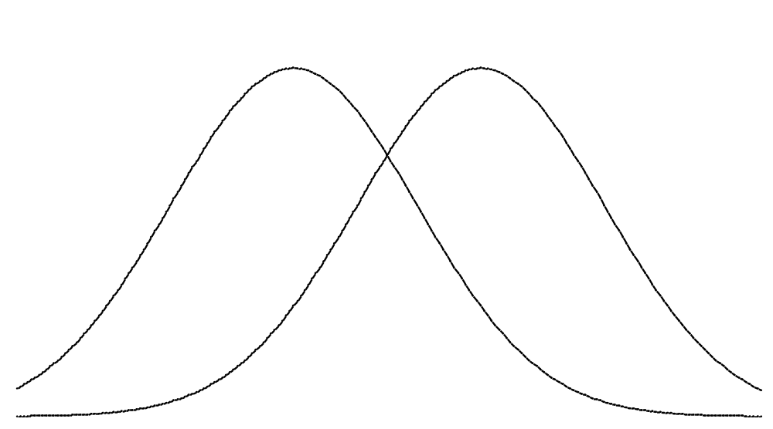
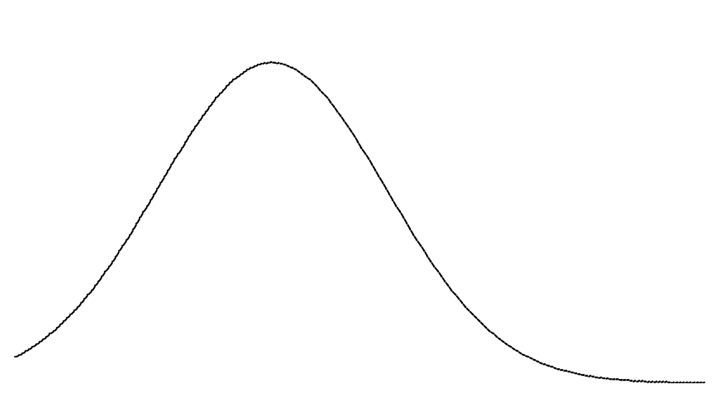
Type-I and Type-II Errors
Probability of failing to reject
H₀ when H₀ is false
Probability of rejecting
H₀ when H₀ is true

Slide 36
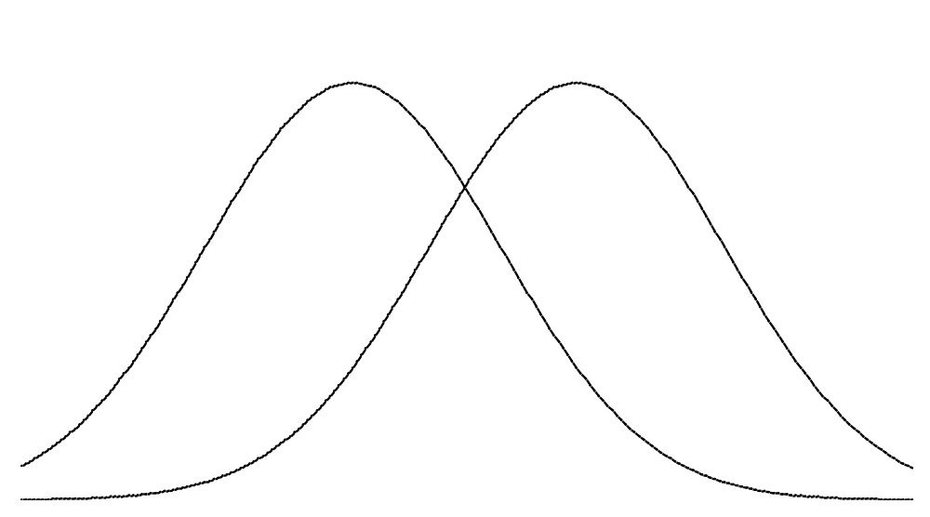

Slide 37
Thank You
Slide 3-<number>

